Slide 1



AWS Project
TEAM 4

Slide 2




PHILOPATEER
MOATAESM
MOSTAFA
BELAL

Slide 3
TABLE OF CONTENTS
01
02
03
04
05
06
Create Network Environment
Host Web App on EC2
Store App Static Content on S3
Mount S3 on EC2
Secure, Scalable, HA, and DR
Enable Redirection on Load Balancer

Slide 4




01
Create Network Environment

Slide 5
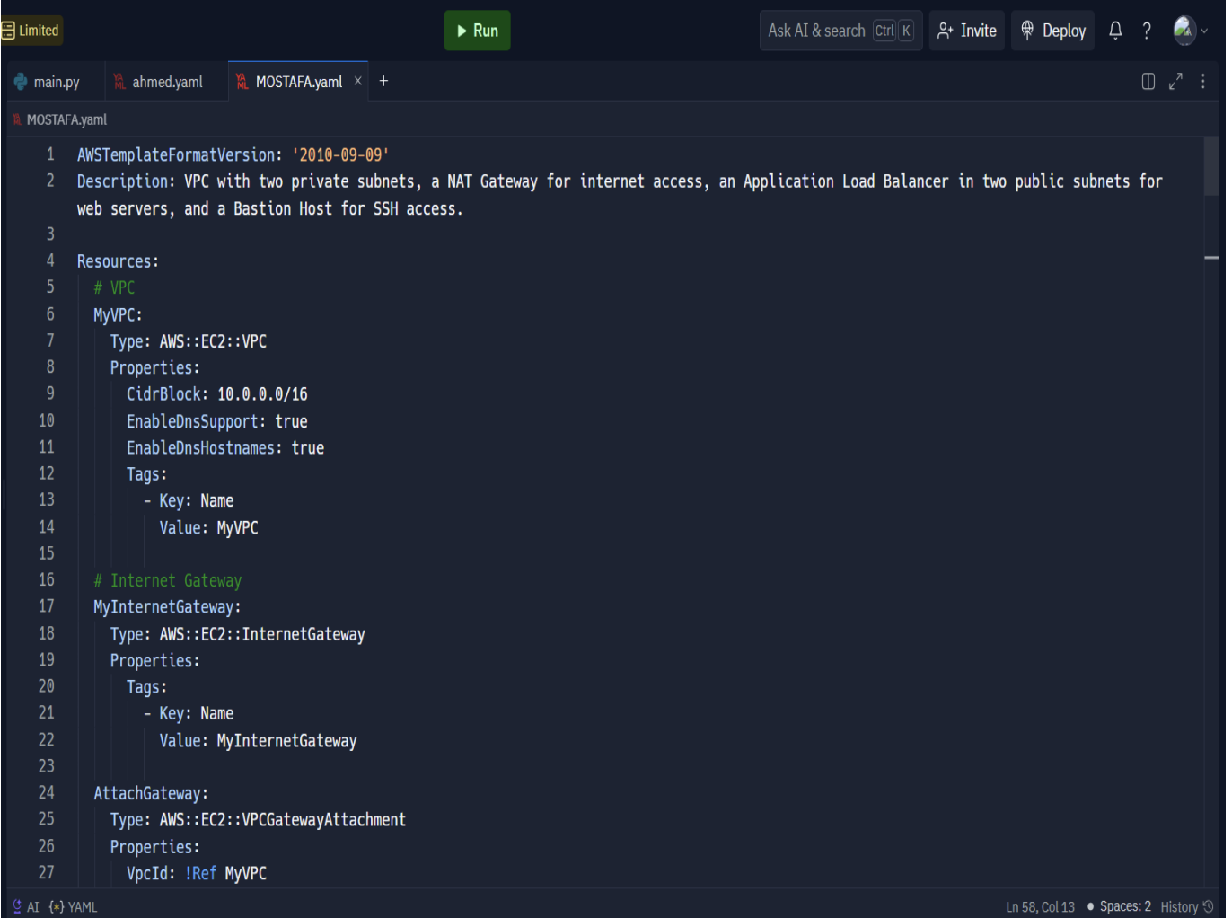
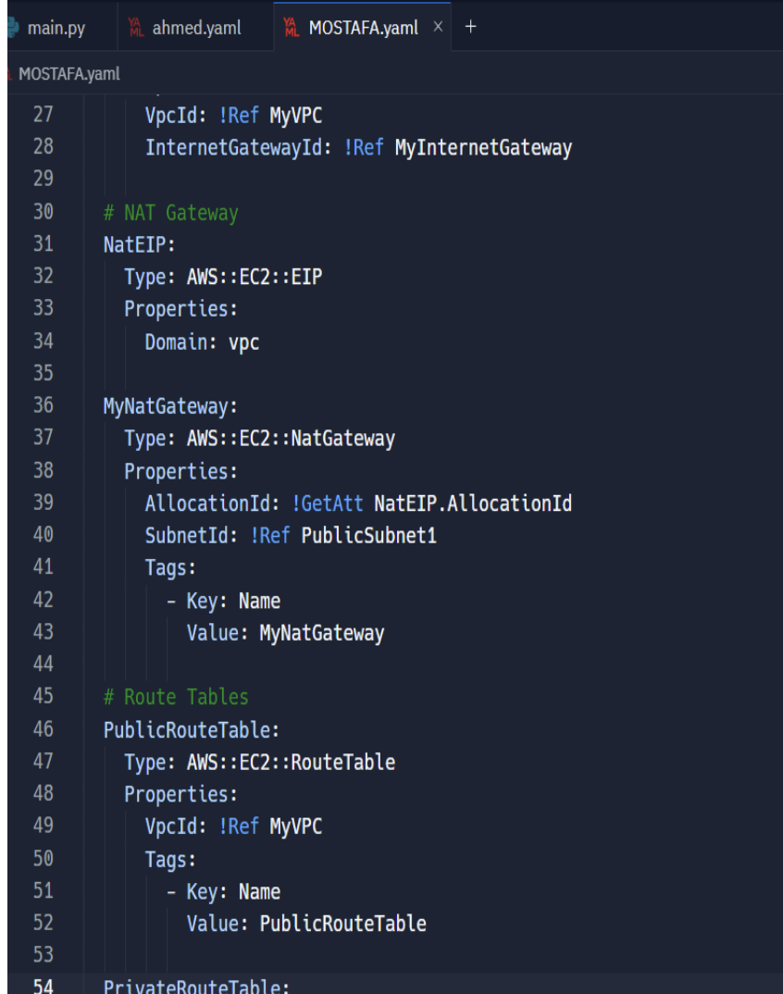
1. Create Network Environment with Infrastructure as Code (IaC)

Slide 6
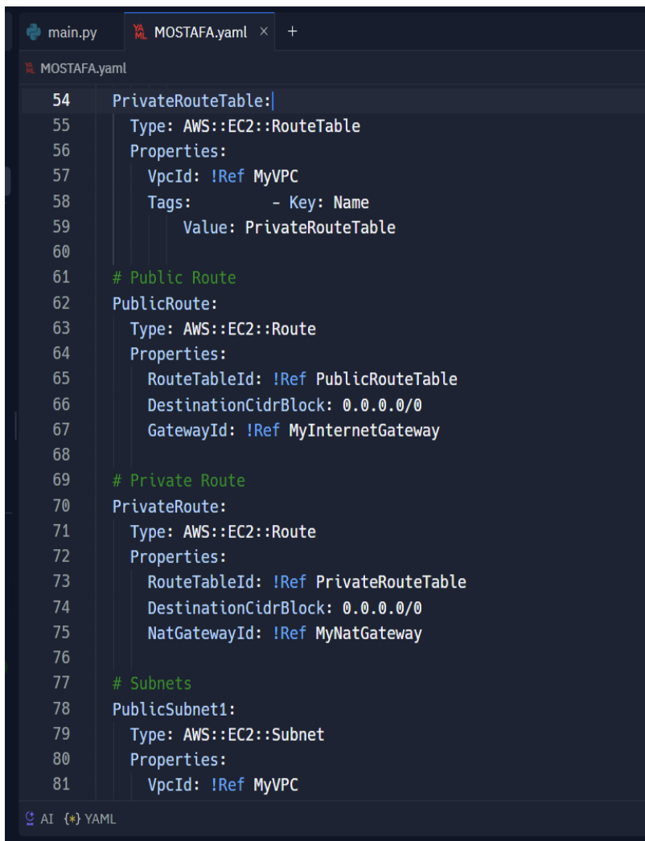
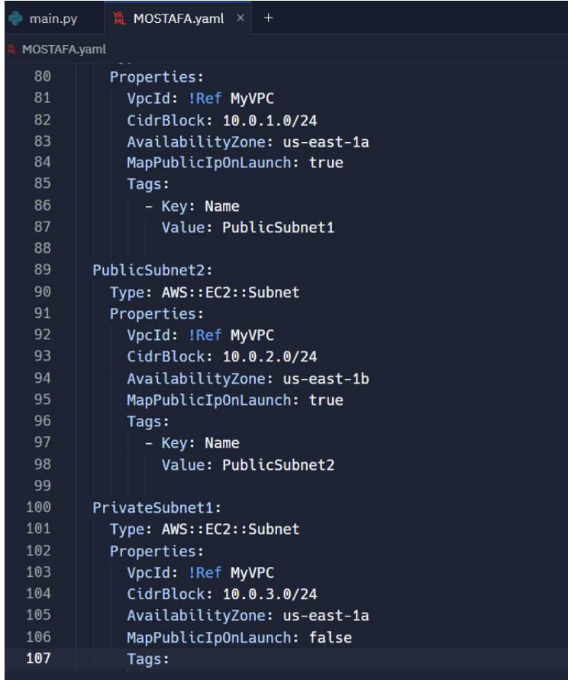
1. Create Network Environment with Infrastructure as Code (IaC)

Slide 7
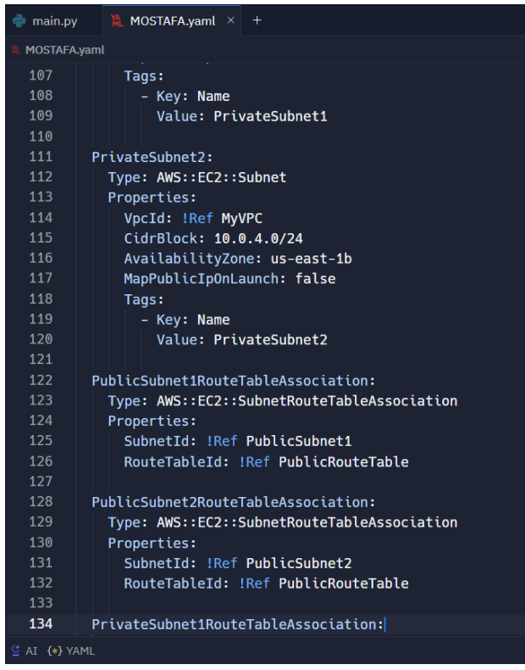
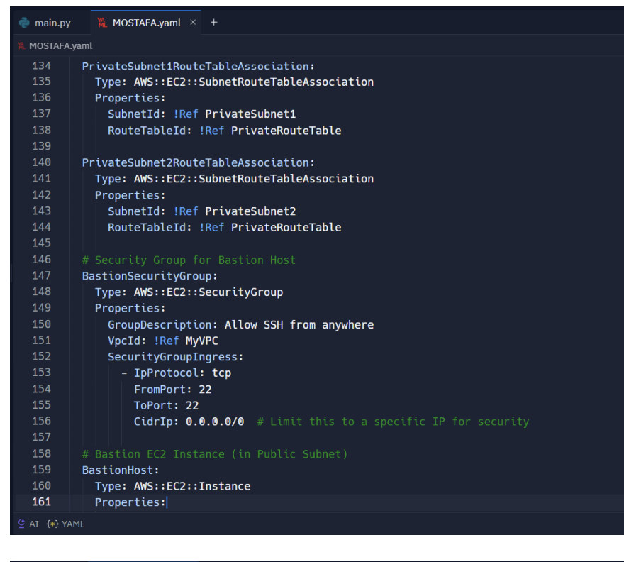
1. Create Network Environment with Infrastructure as Code (IaC)

Slide 8
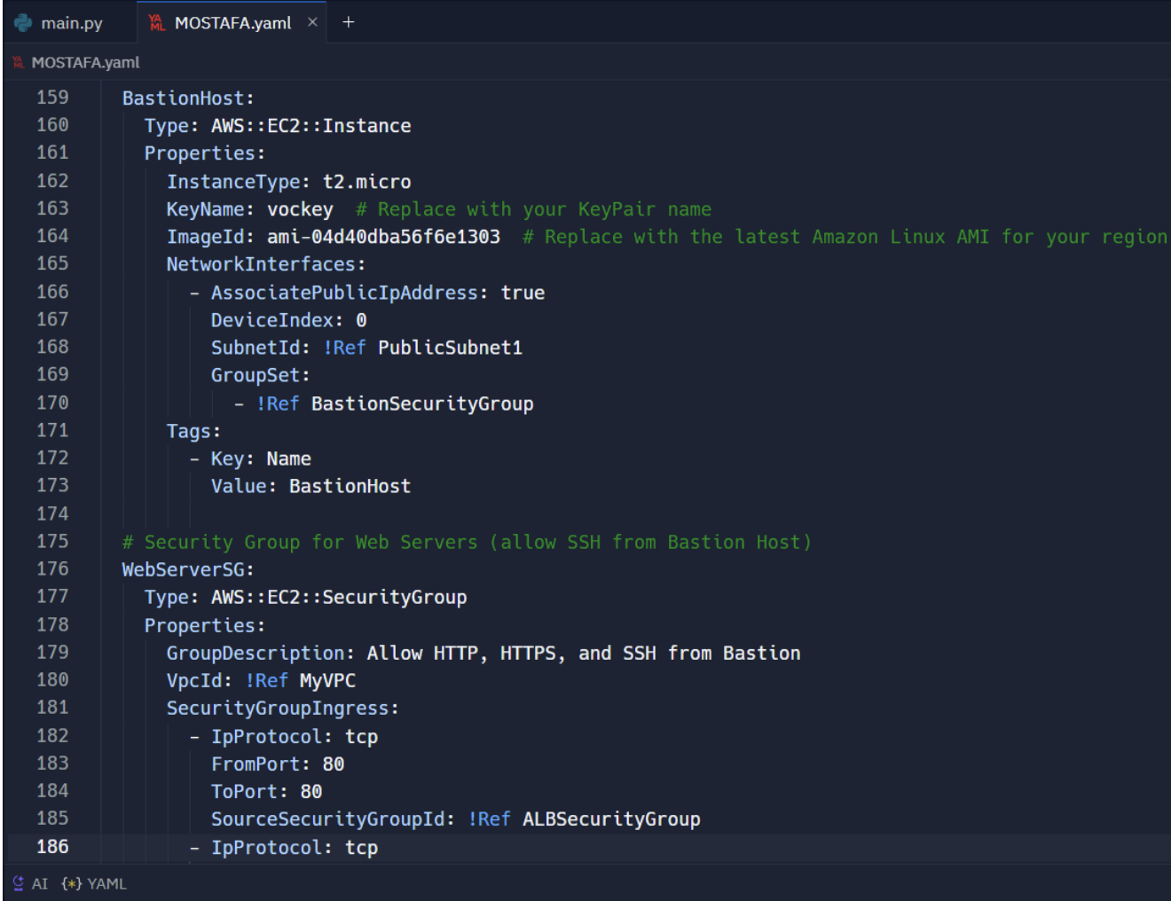
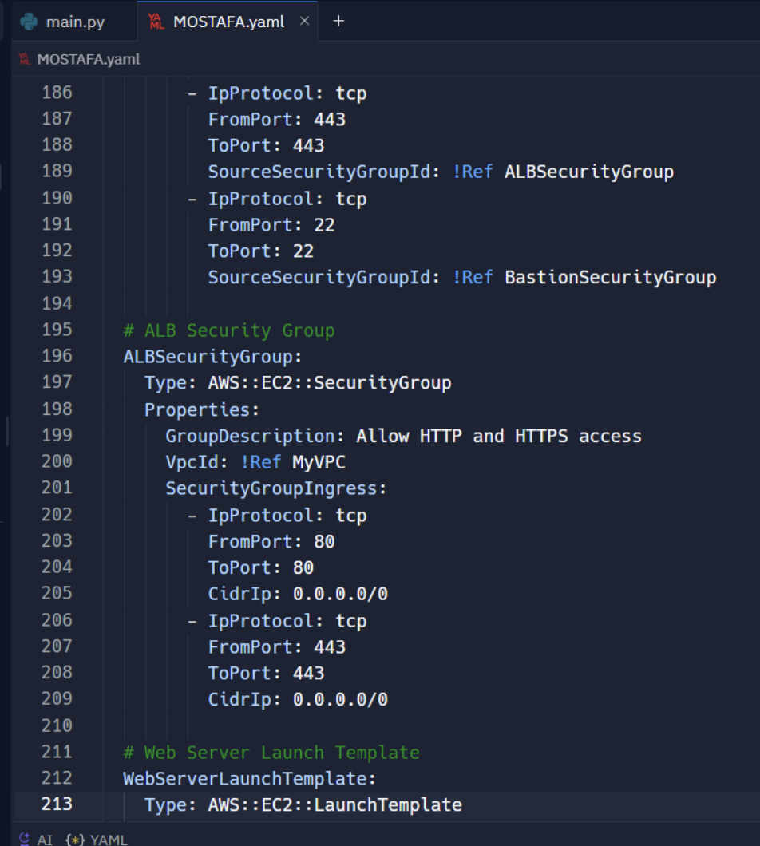
1. Create Network Environment with Infrastructure as Code (IaC)

Slide 9
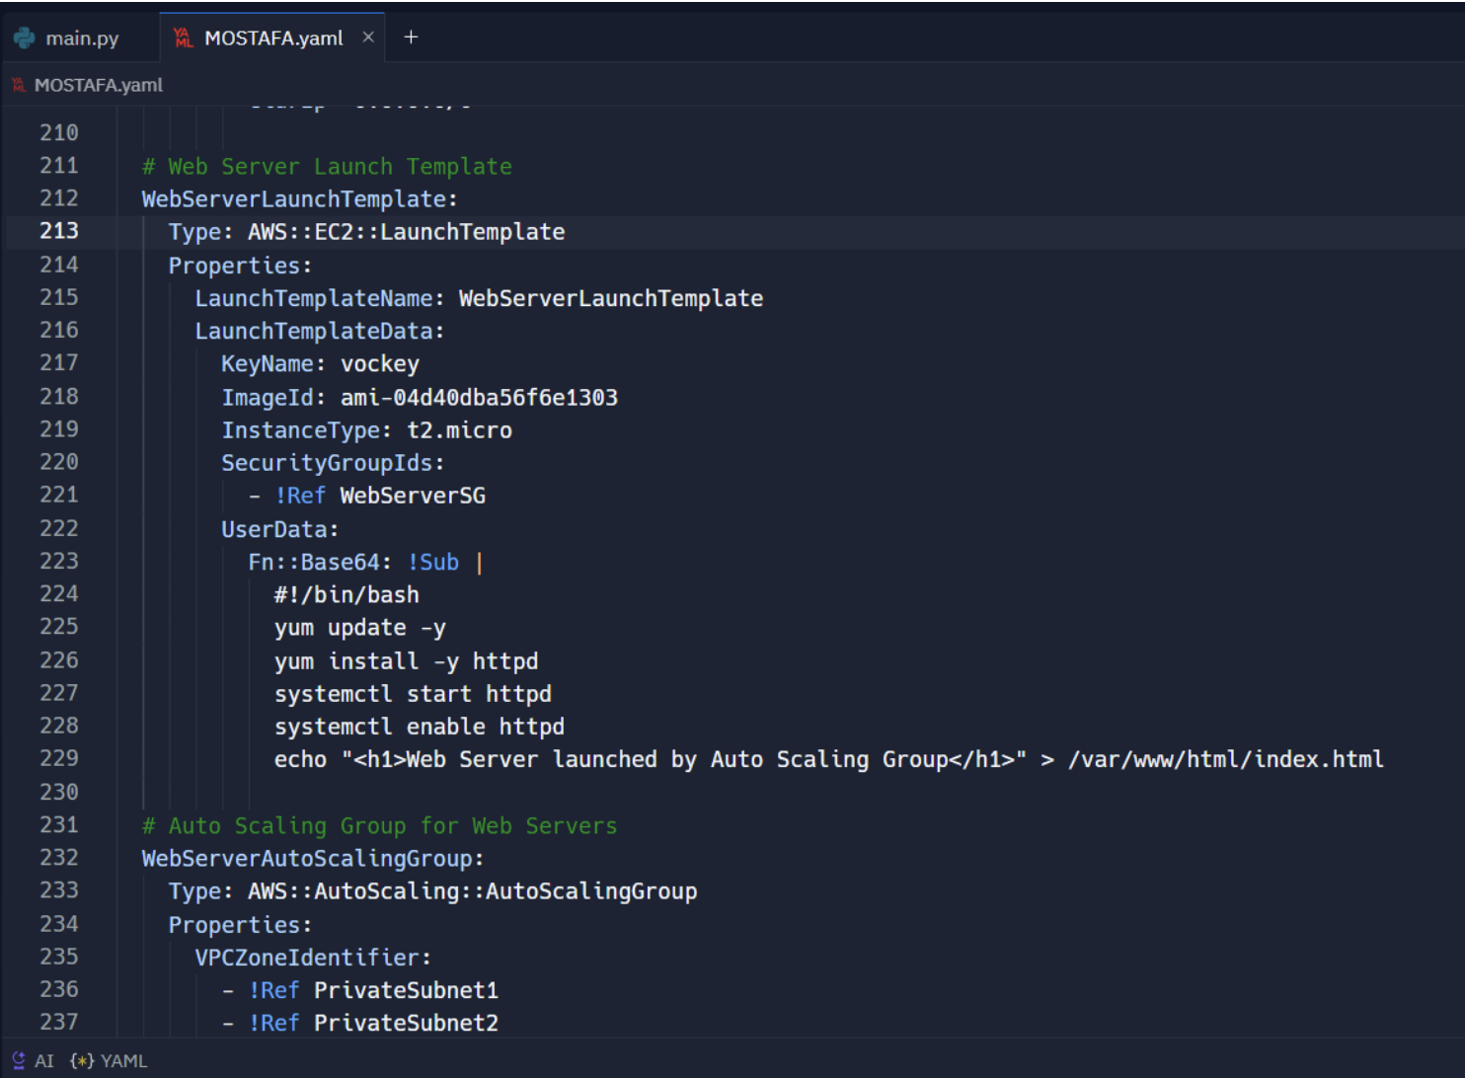
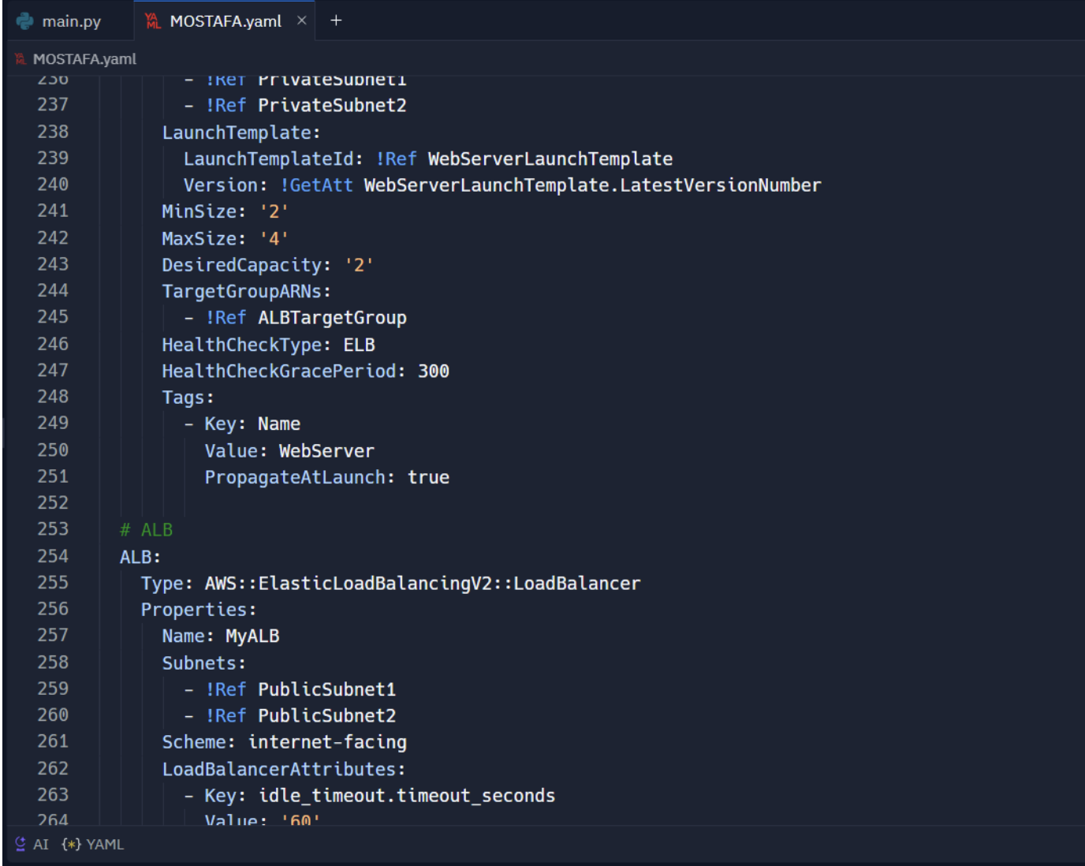
1. Create Network Environment with Infrastructure as Code (IaC)

Slide 10
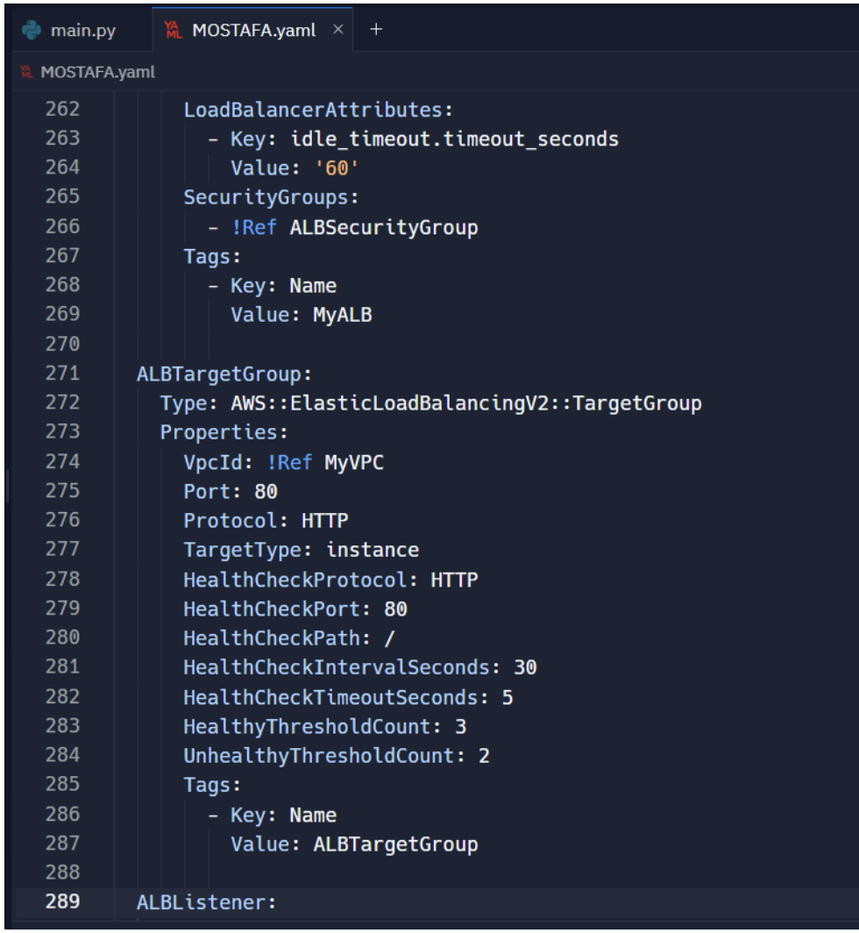
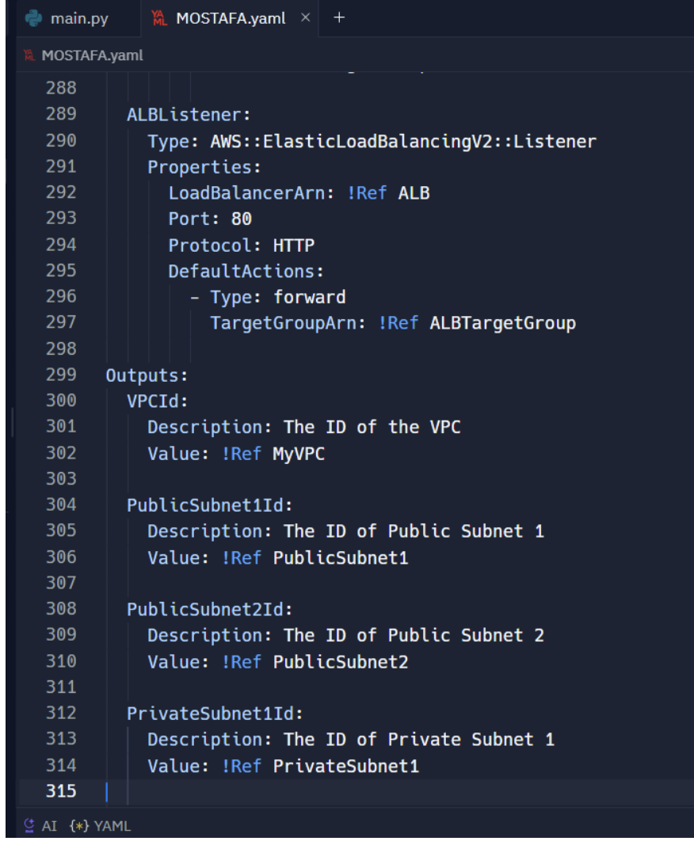
1. Create Network Environment with Infrastructure as Code (IaC)

Slide 11
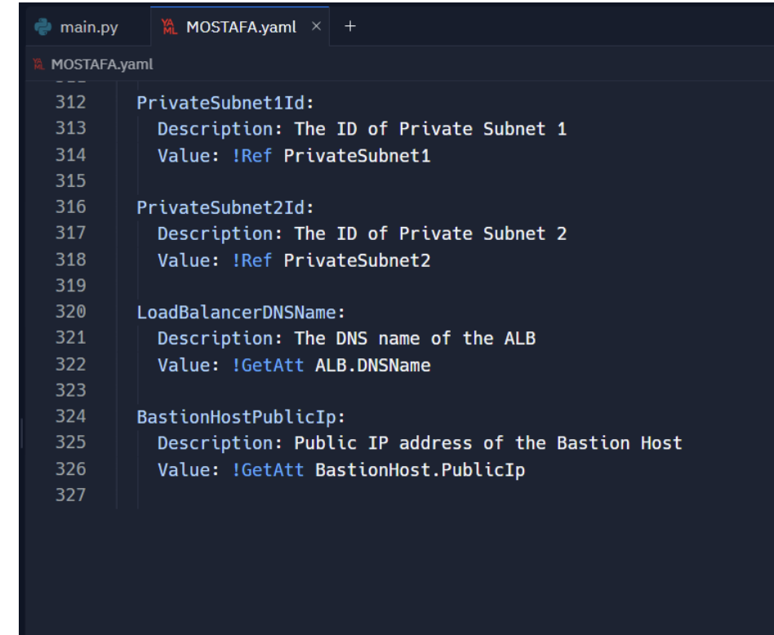
1. Create Network Environment with Infrastructure as Code (IaC)

Slide 12
02
Host Web App on EC2

Slide 13
2. Host Web App on EC2 or Using Microservices
Use Amazon EC2 or Amazon ECS/EKS for deploying web apps or containerized microservices.
Use Auto Scaling to ensure high availability and scalability. Deploy Elastic Load Balancers across multiple Availability Zones for redundancy and traffic distribution.

Slide 14
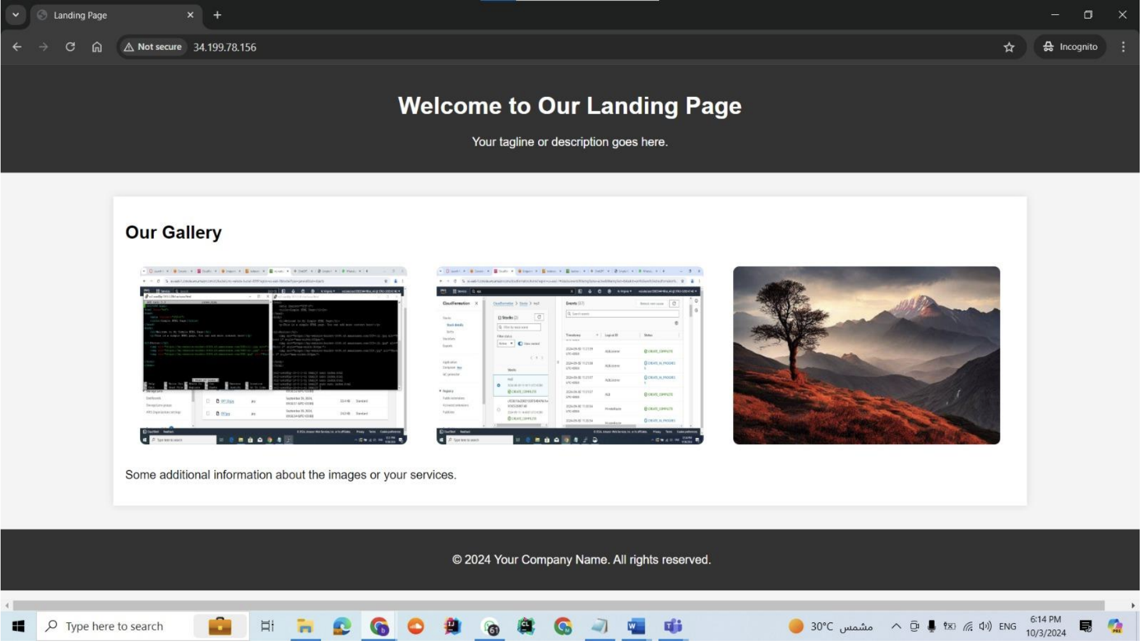

2. Host Web App on EC2 or Using Microservices

Slide 15
03
Store App Static Content on s3

Slide 16
2. Host Web App on EC2 or Using Microservices
Enable S3 Versioning for backup and recovery and use CloudFront as a CDN to improve latency and user experience globally

Slide 17
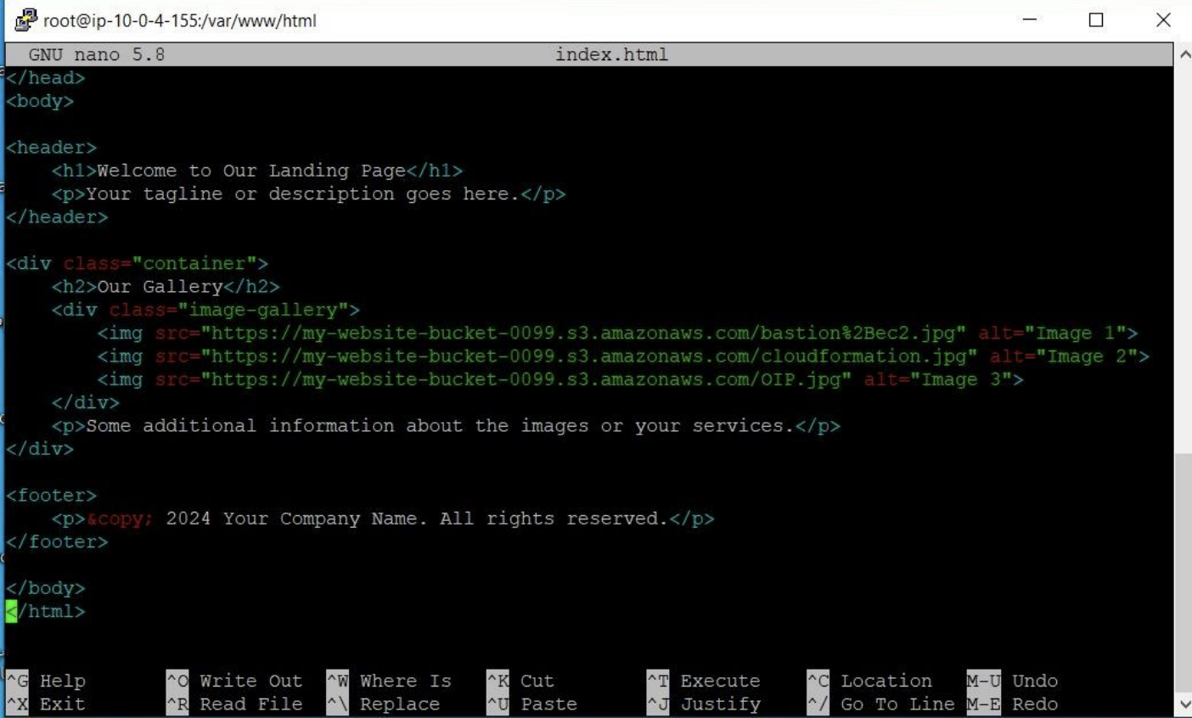
3. Store App Static Content on s3

Slide 18
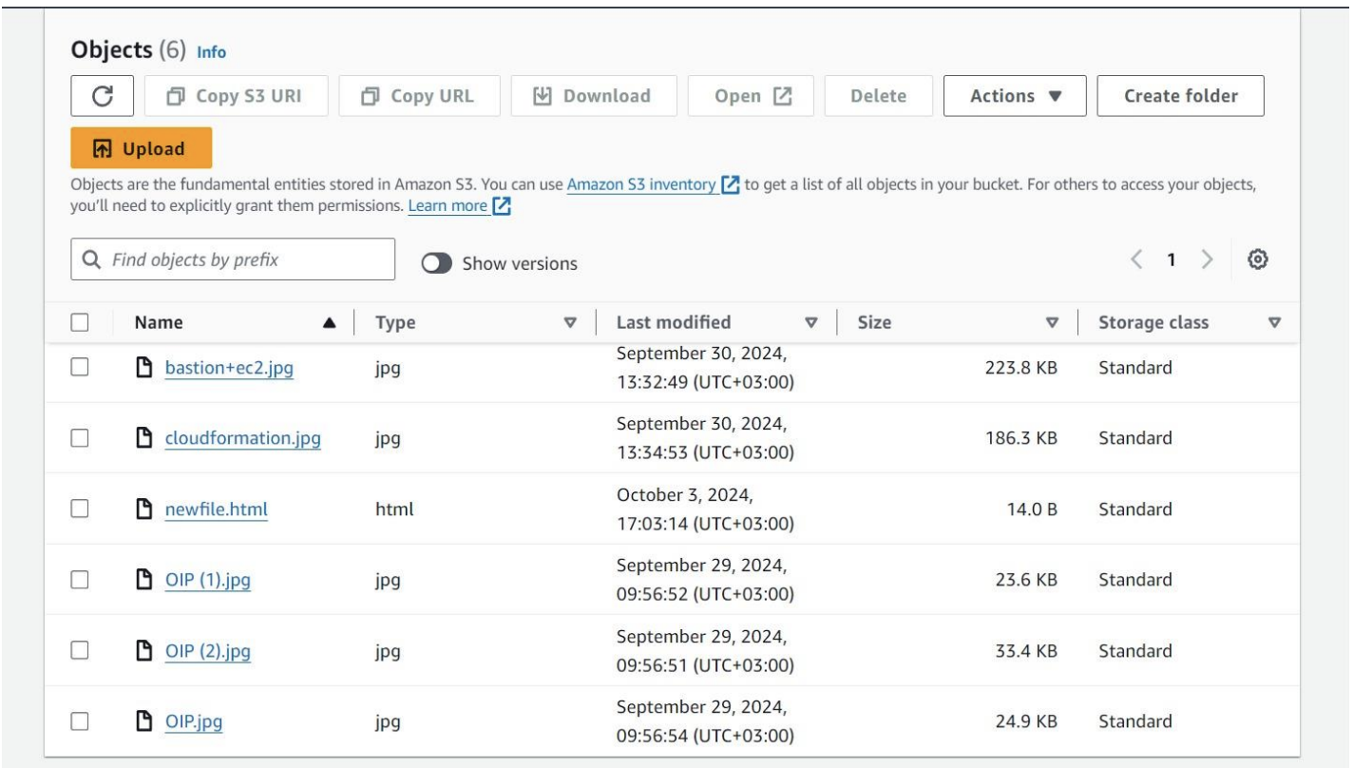
2. Host Web App on EC2 or Using Microservices

Slide 19
04
Secure, Scalable, High Availability, and Disaster Recovery

Slide 20
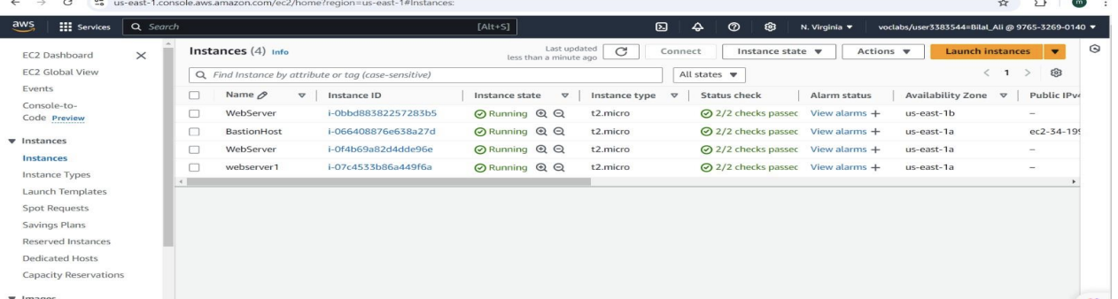
4.Secure, Scalable, High Availability, and Disaster Recovery
Use IAM for security, Auto Scaling for scalability, and Multi-AZ deployment for high availability.
Highly available with two availability zones

Slide 21
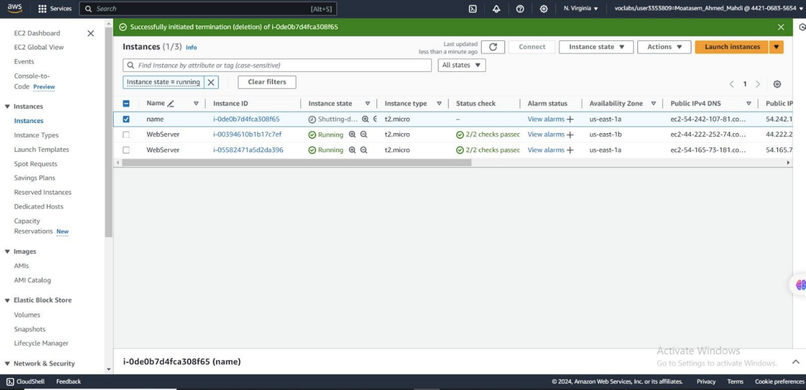
4.Secure, Scalable, High Availability, and Disaster Recovery
Web server multi-AZ

Slide 22
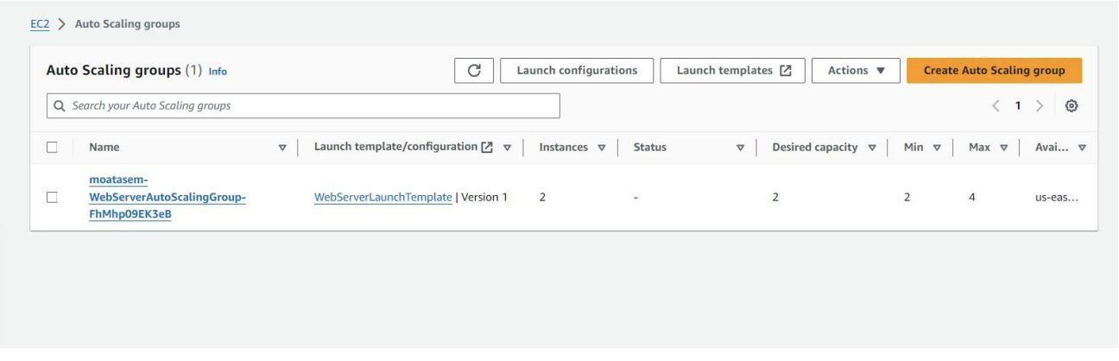
4.Secure, Scalable, High Availability, and Disaster Recovery
Auto scaling

Slide 23
05
Enable Redirection on Load Balancer (HTTP to HTTPS)

Slide 24
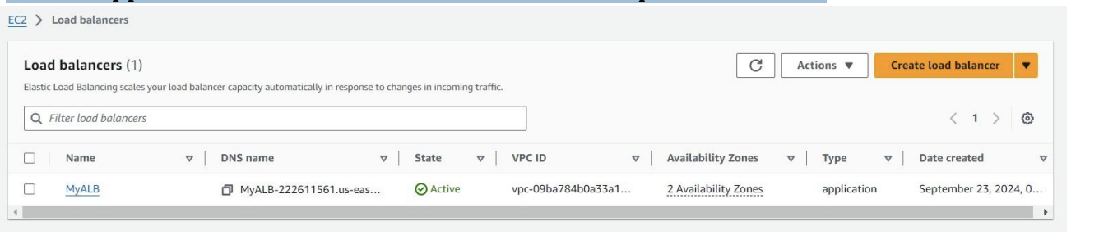
4.Secure, Scalable, High Availability, and Disaster Recovery
Use an Application Load Balancer to redirect HTTP requests to HTTPS.

Slide 25
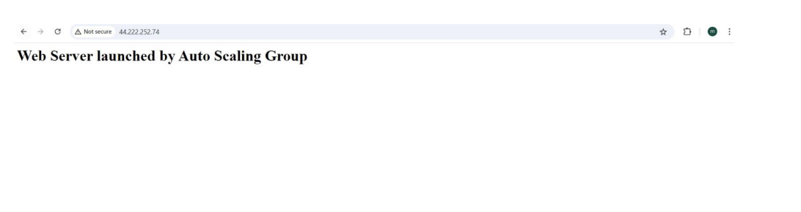
4.Secure, Scalable, High Availability, and Disaster Recovery
Use SSL/TLS certificates self-signed certificate to ensure encrypted communications.

Slide 26
06
Mount S3 on EC2

Slide 27
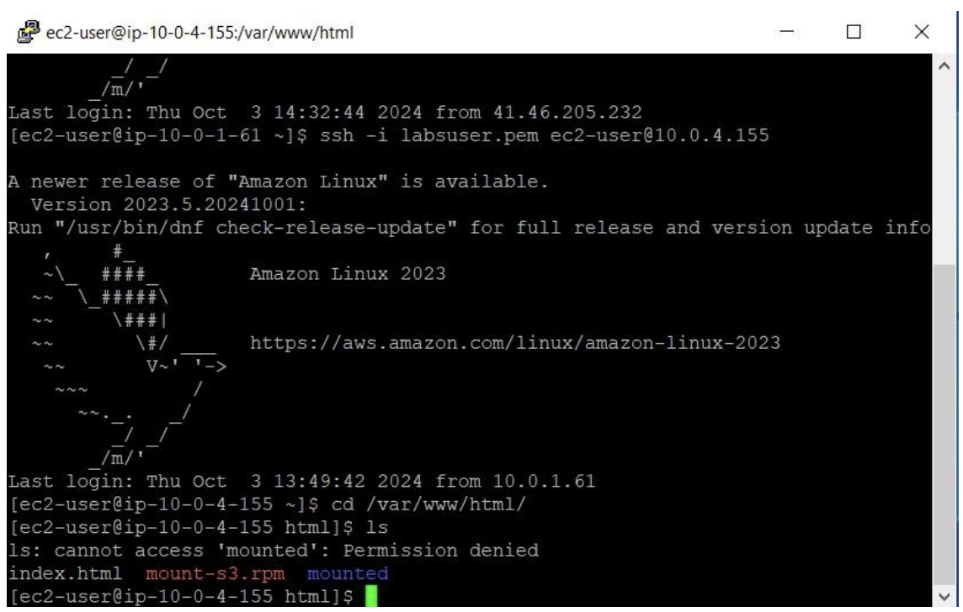
6. Mount S3 on EC2
: Use s3fs or AWS CLI to mount an S3 bucket on your EC2 instance.

Slide 28
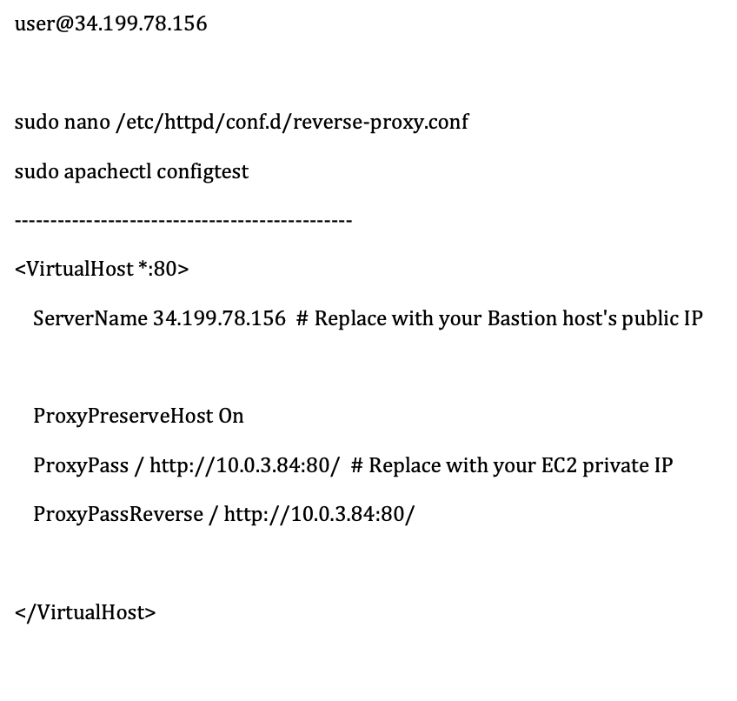
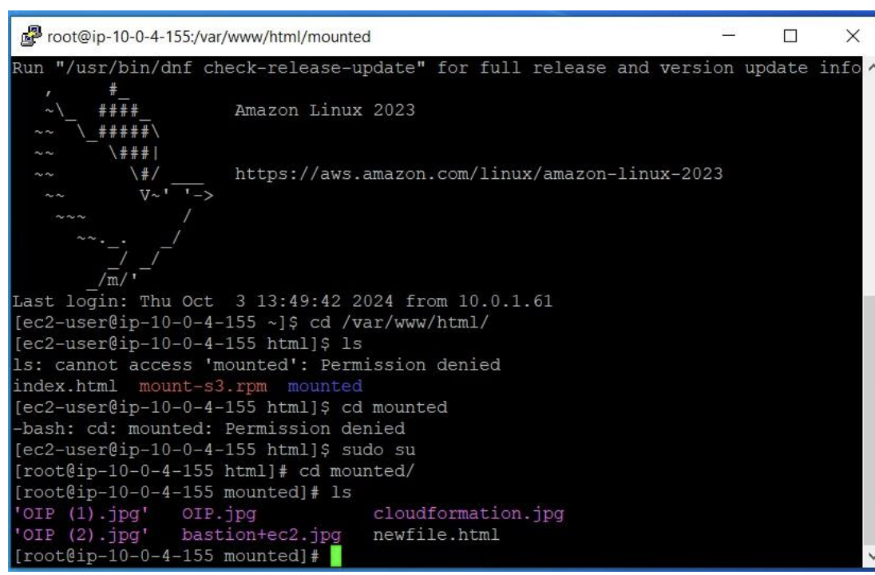
6. Mount S3 on EC2
: Use s3fs or AWS CLI to mount an S3 bucket on your EC2 instance.

Slide 29
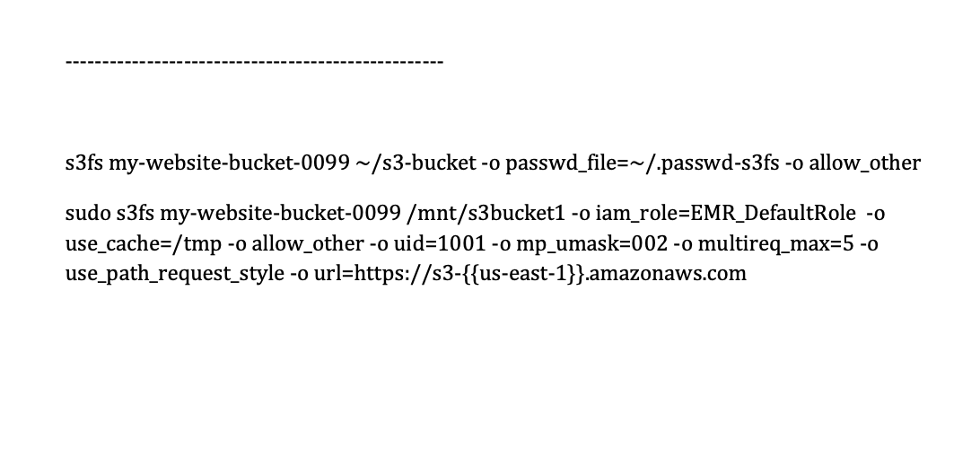
6. Mount S3 on EC2

Slide 30
THANKS!
Do you have any questions?
youremail@freepik.com
+34 654 321 432
yourwebsite.com
Please keep this slide for attribution

